Slide 1
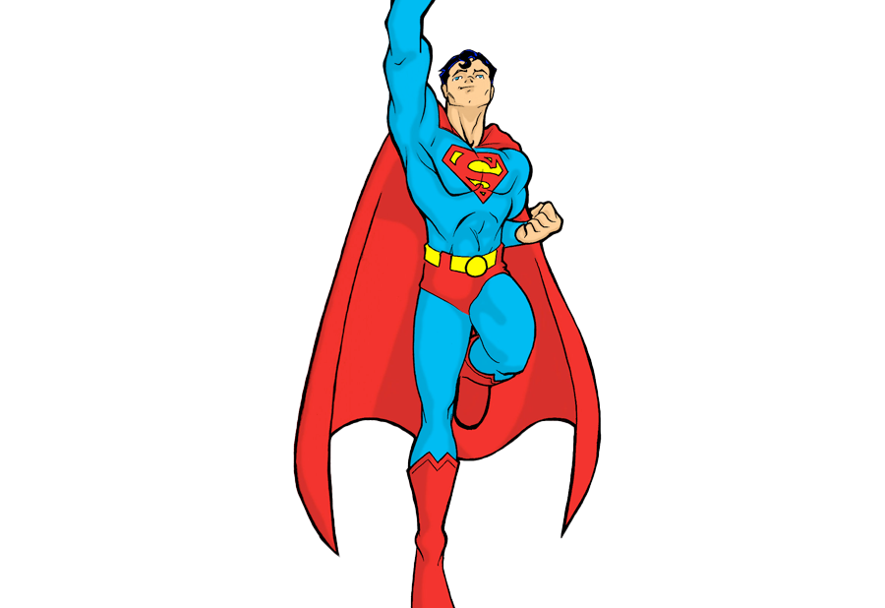
Superman: Clarke Kent Explores Self Assembly
Northwestern Splash
Haley Wellman
April 2nd

Slide 2
What is supramolecular chemistry?
Chemical schemes that contain a discrete amount of molecules
Weak, non-covalent reversible bonds

Slide 3
Non-covalent forces
Ionic bonds
Hydrophobic interactions
Hydrogen bonding
Van Der Waals Forces
Dipole Dipole bonds

Slide 4
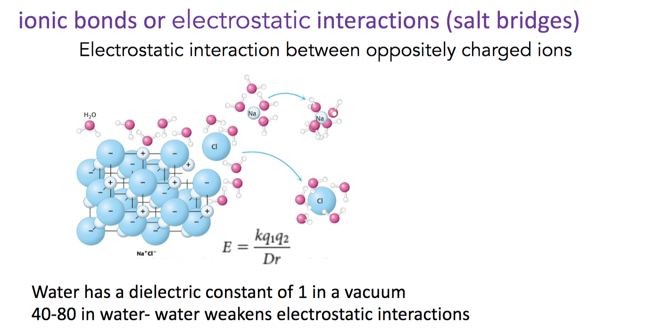
Ionic Bonds

Slide 5
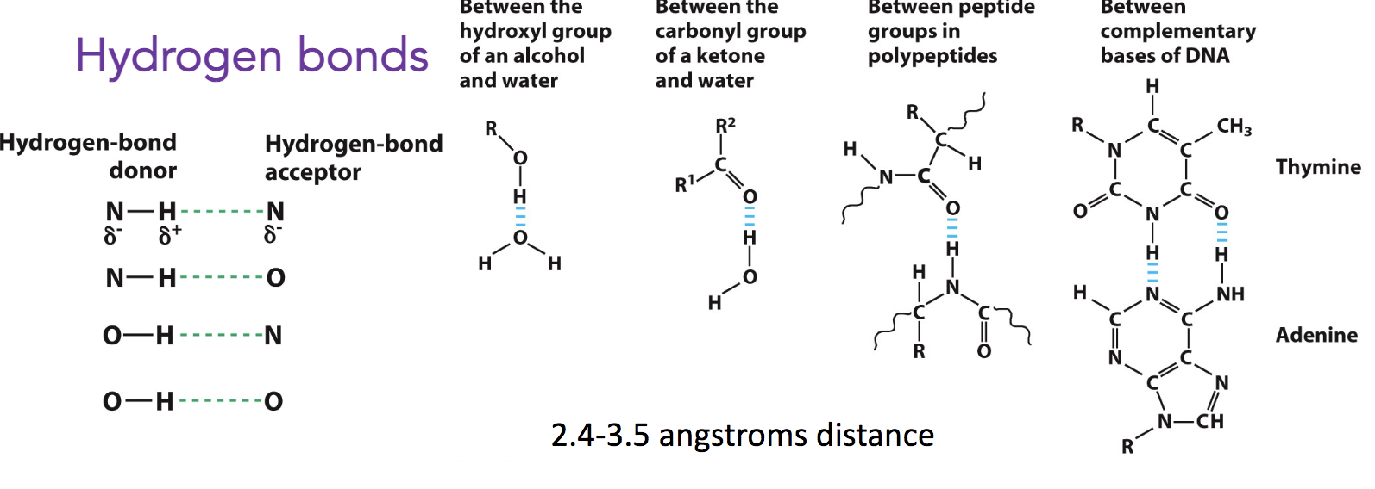
Hydrogen Bonds

Slide 6
Peptide Amphiphiles

Slide 7


Current Approach to Discovering Bioactive PAs

Slide 8
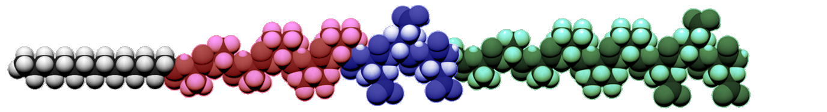
Bioactive Epitope

Slide 9
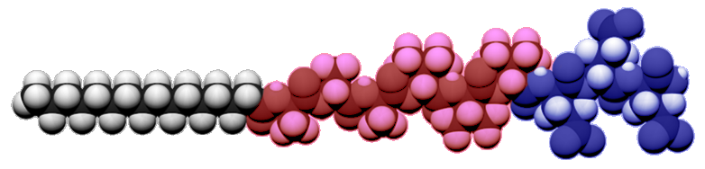
Bioactive Epitope
Micellar
Fibrous
Peptide Amphiphile Backbone
C16 VVVAAA EEE

Slide 10
Diluent PA / Co-Assembly
Bioactive Epitope
Micellar
Fibrous
Peptide Amphiphile Backbone
C16 VVVAAA EEE

Slide 11
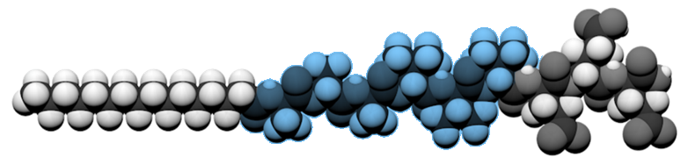
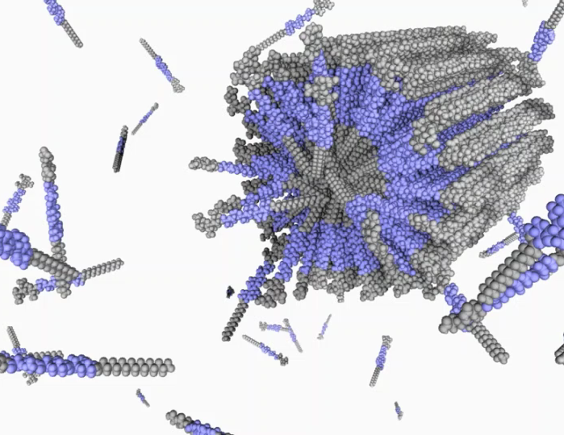
Self-Assembly and Nanostructures
Micelles
Fibers
Bilayers
Notes:
Important Properties
Strength and directionality of interactions
Intramolecular forces:
H Bonding, aromatic stacking, VDW forces, electrostatic attraction, salt bridges, p-orbital stability
High internal order
Variables
Solubility: mM of PA dissolved
pH: indicates charge on amino acids
Type of peptide and side chain: Hydrophobic, hydrophilic, aromatic, aliphatic
Salt Concentration: Ionic Strength
N terminus modifications
C terminus modifications

Slide 12
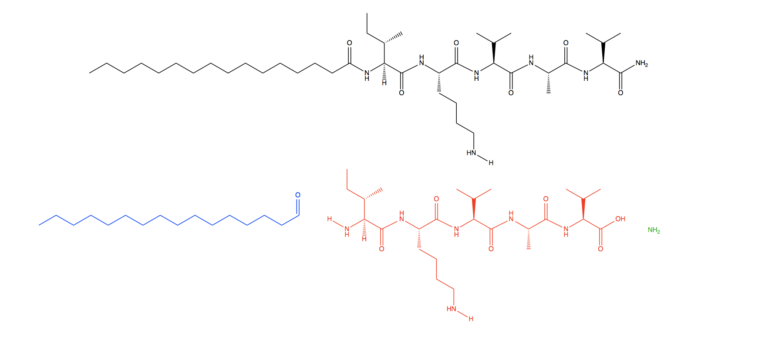
Molecular Structure
Peptide Amphiphile C16-IKVAV-NH2
N– Terminus Modification
C– Terminus Modifications
Peptide Sequence
Notes:
Saving everything

Slide 13
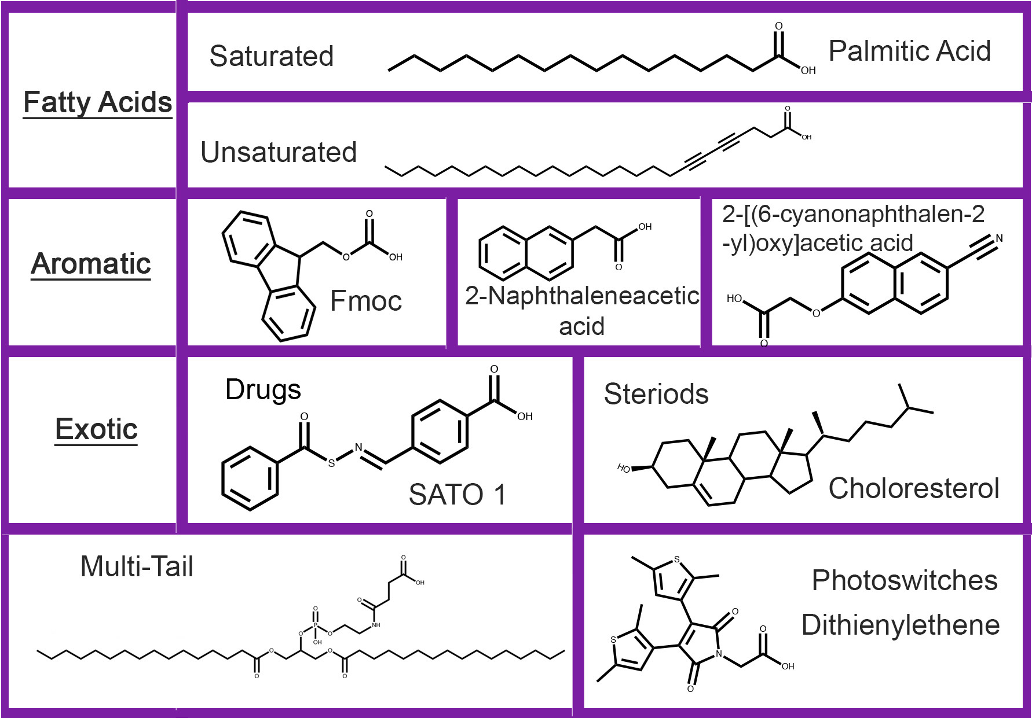
Molecular Design of PAs
HYDROPHOBIC TAIL
CHARGED HEAD GROUP
N– Terminus Modifications
HYDROGEN BONDING SEGMENT
C– Terminus Modifications
Amide Group
Methyl Group
Reverse PAs
  Fatty Acids and Lys
Notes:
Supramolecular polymers connected through noncovalent bonds with shape persistence nanostructure and high internal order
Building blocks: amino acids, nucleic acids, sugars, lipids
Focusing on amino acids because have been heavily studied and found in nature Example: Central Dogma process, protein folding, proteostasis network
Specific nanostructures
Most common: fibers (tangled so stronger network)
Important properties
Made by modifiying lysine when synthesized it- lysine at c terminus that we modified with a hydrophobic tail
Why modify the C and N terminus?

Slide 14
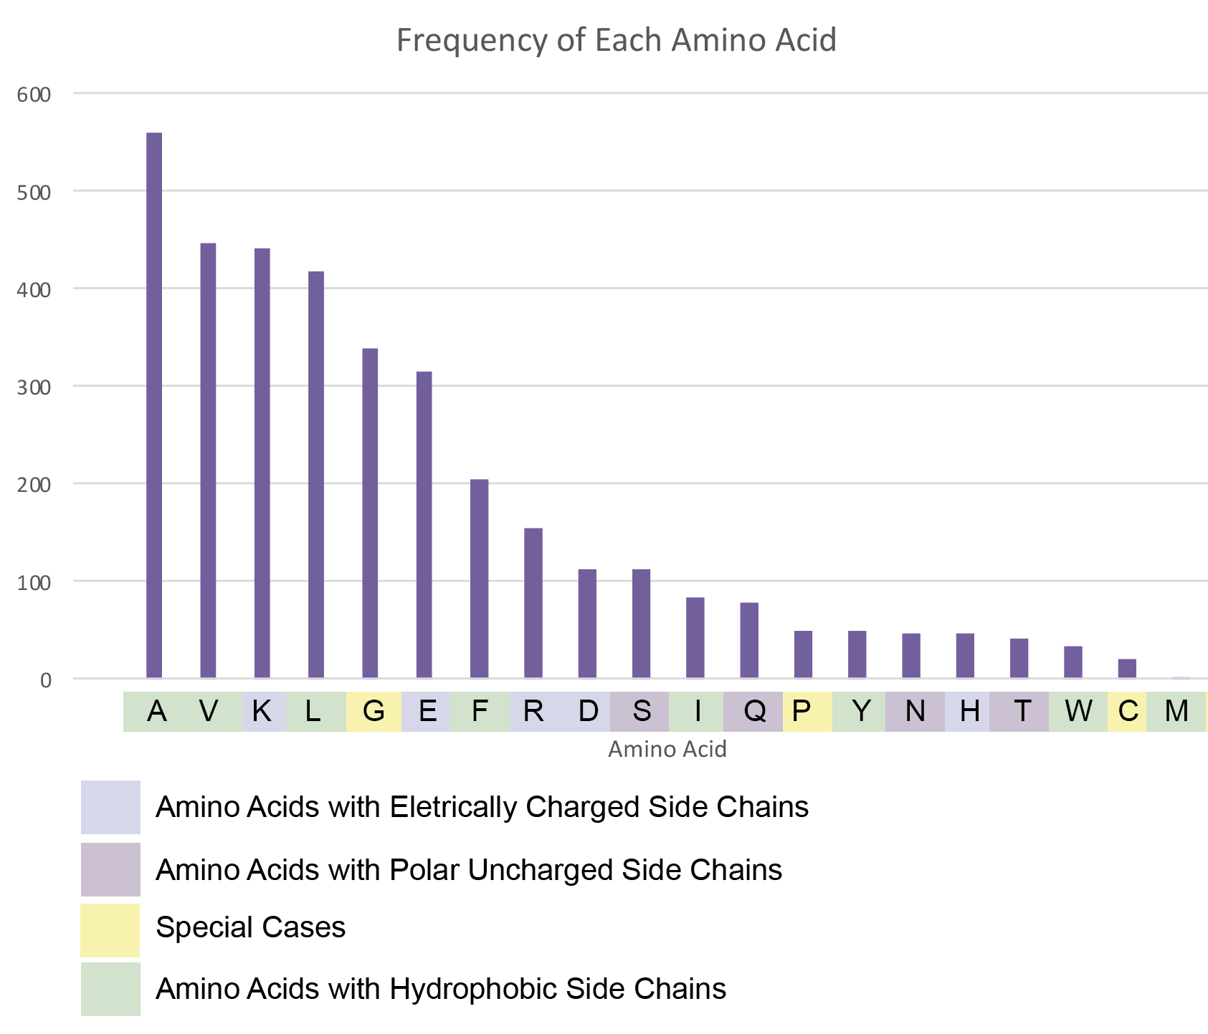
Amino Acids

Slide 15
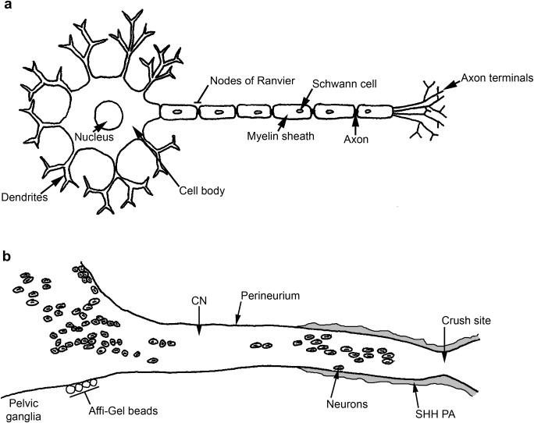
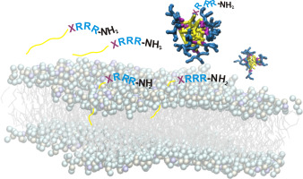
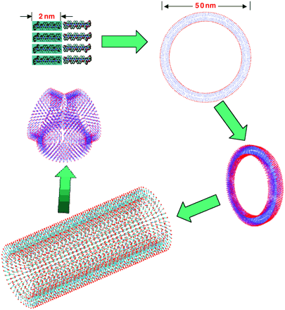
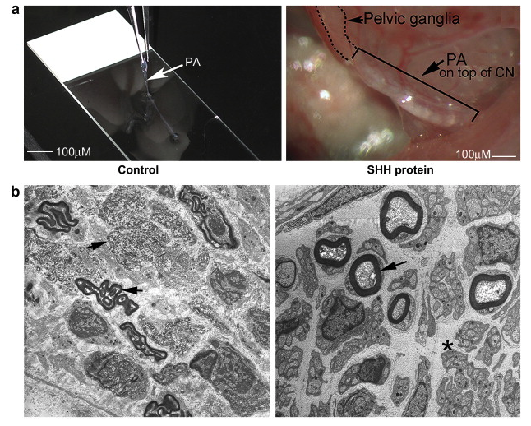
Benefit of PAs and Their Morphologies
Micelles
Fibers
Bilayers
Membrane binding of lipopeptides
Micellization of lipid bilayer
Antimicrobial and cytotoxic activities
Peripheral nerve regeneration
Complex structures
Nanotubule formation mirrors lipid microtubule structures
BBA - Biomembranes 1860 (2018) 2242–22512243
N.L. Angeloni et al. / Biomaterials 32 (2011) 1091e11011092
PNAS ( 2002) 99 (8) 5355-53606881
Notes:
Important Properties
Strength and directionality of interactions
Intramolecular forces:
H Bonding, aromatic stacking, VDW forces, electrostatic attraction, salt bridges, p-orbital stability
High internal order
Variables
Solubility: mM of PA dissolved
pH: indicates charge on amino acids
Type of peptide and side chain: Hydrophobic, hydrophilic, aromatic, aliphatic
Salt Concentration: Ionic Strength
N terminus modifications
C terminus modifications

Slide 16
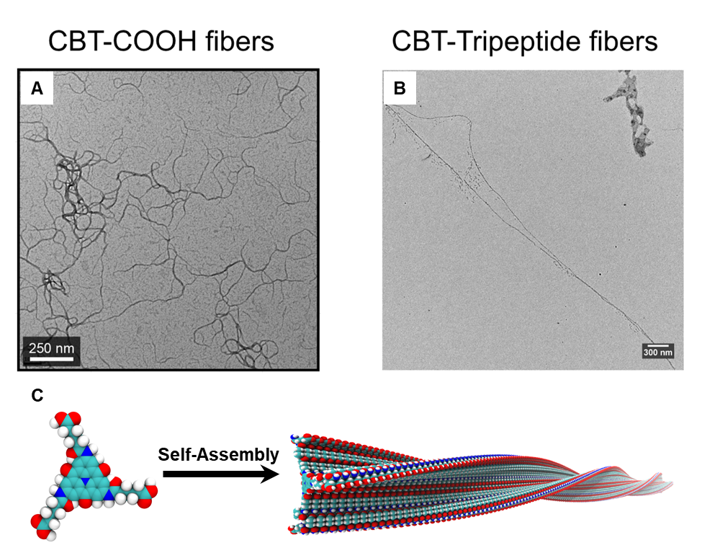
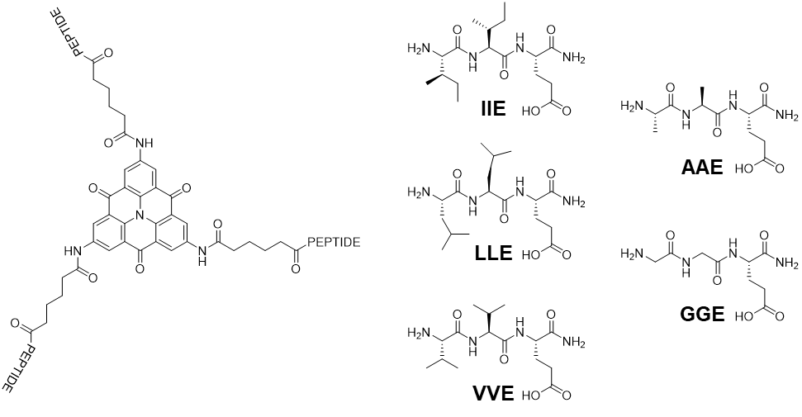
Applications in Research: CBT
Scheme 1: Synthesis of Carbonyl Bridged Triarylamine (1) 2,6,10-tris(6-carboxylhexylamine)benzo [1,9] quinolizino[3,4,5,6,7-defg]-4,8,12-tirone
A, Transmission electron microscopy (TEM) micrographs of the original CBT-COOH molecule showing the formation of short nanofibers after the molecule self-assembles in water. B, TEM micrographs of the CBT-tripeptide with the VVE peptide sequence showing the formation of long nanofibers after the molecule self-assembles in water. C, Schematic representation of how the CBT-tripeptide molecules assemble in water by forming twisted stacks where the molecules orient themselves in planar stacks long the π - π stacking direction. These long fibers can then be used to form a synthetic scaffold for neural regeneration.
Chemical structures of the carbonyl bridged triarylamine (CBT) modified with different tripeptides. The generalized structure of the CBT-tripeptides is shown on the left with the five different tripeptide sequences use to modify the CBT core shown on the right.

Slide 17
Oligoprolines

Slide 18
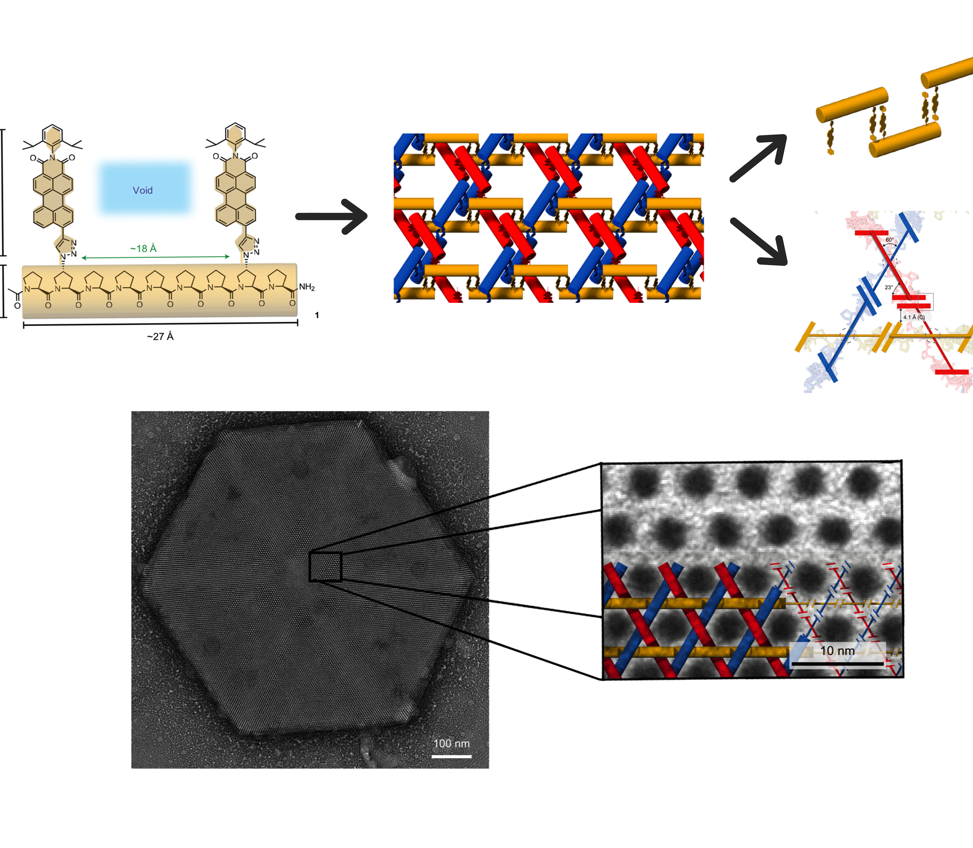
Triaxial Supramolecular Weave

Slide 19
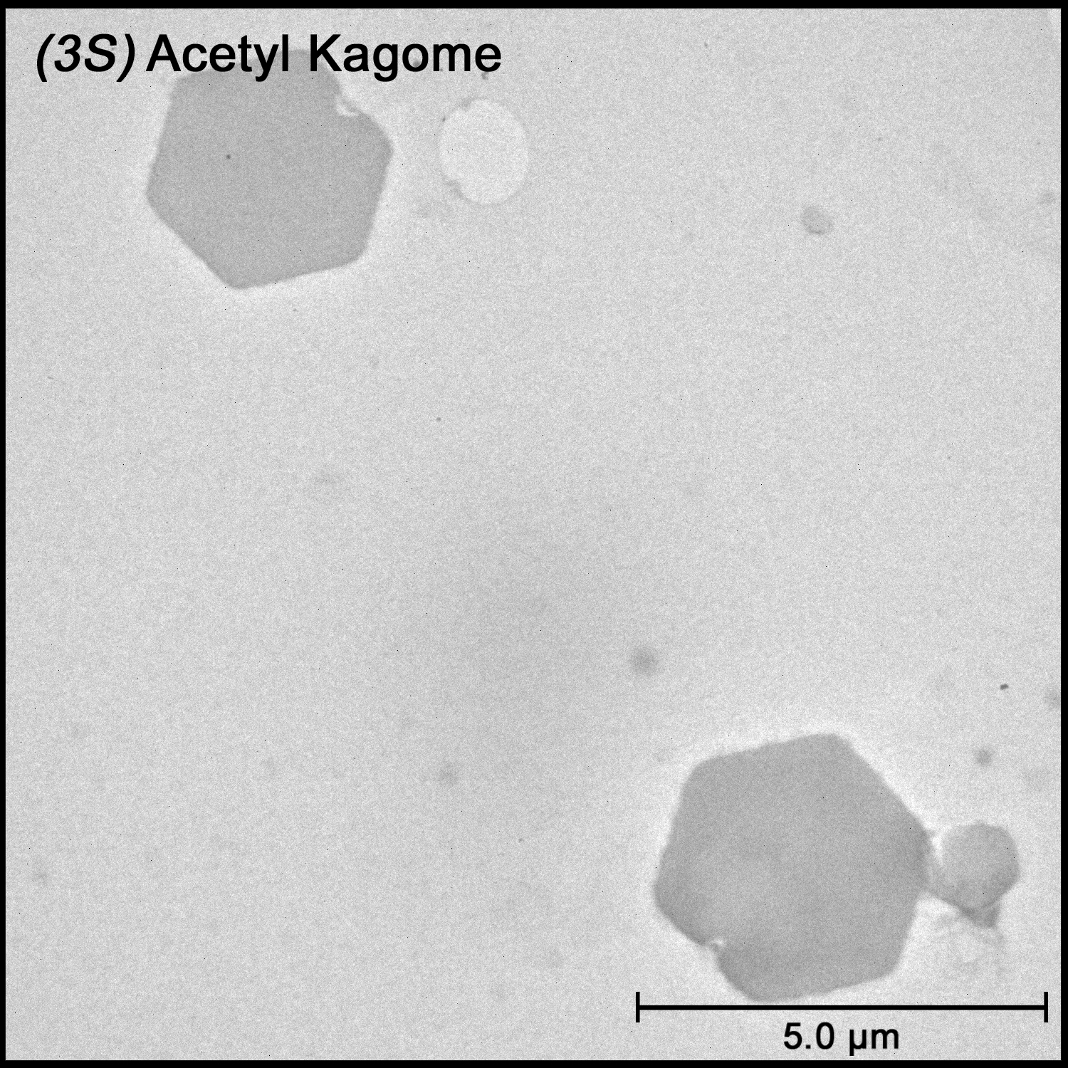
Image of Woven Kagome

Slide 20
